Slide 1
Control Systems
Sajeeth Kumar
Lecture 03 – SI Control Strategies

Slide 2
Scope
Overview of SI Engine Control Strategies
Calibration Requirements
Testing, Verification & Validation
Learning Outcomes
Laplace Transform Examples
Building simple plant models
Module Contents

Slide 3
Introduction
Convolution & Laplace Transform
Convolution – Mathematically tough to solve
Convolution = Product of Laplace Transforms
Laplace Transform is an integral transformation
Transforms a real variable ( often time “t” ) into a complex variable “s” ( often frequency )
Laplace transform transforms a function from time domain to frequency domain

Slide 4
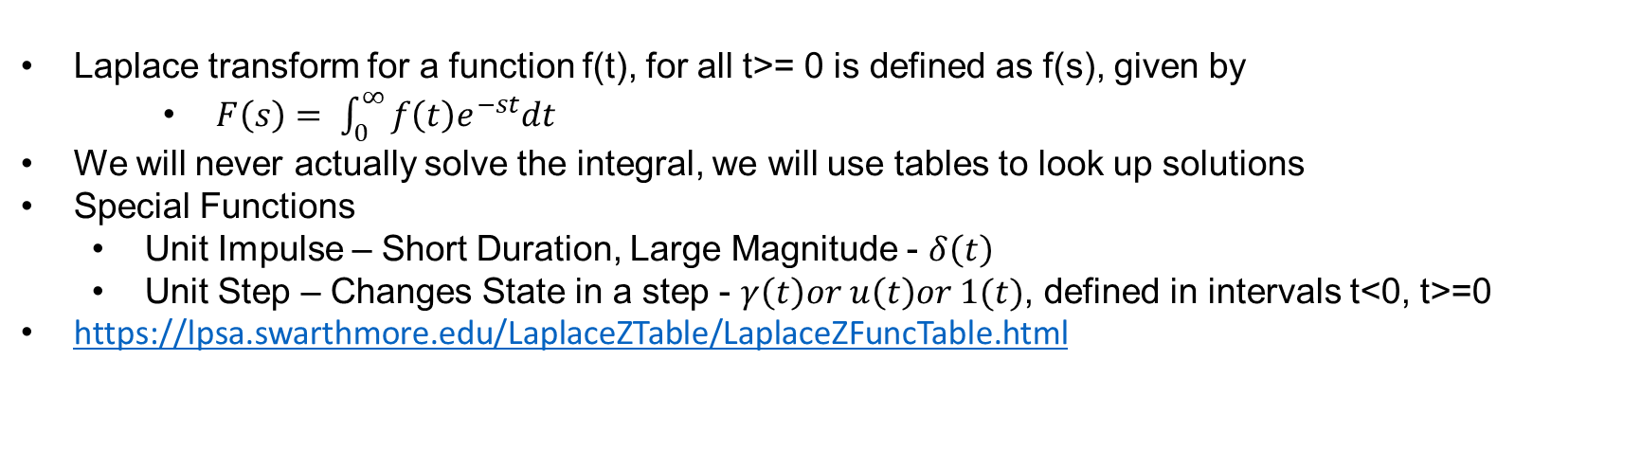
Laplace Transforms
Transform Function
Laplace transform for a function f(t), for all t>= 0 is defined as f(s), given by
$F\left(s\right)= \int_{0}^{∞}{f\left(t\right)e^{−st}dt}$
We will never actually solve the integral, we will use tables to look up solutions
Special Functions
Unit Impulse – Short Duration, Large Magnitude - $δ\left(t\right)$
Unit Step – Changes State in a step - $γ\left(t\right)or u\left(t\right)or 1(t)$, defined in intervals t<0, t>=0
https://lpsa.swarthmore.edu/LaplaceZTable/LaplaceZFuncTable.html

Slide 5
Laplace Transforms
Transform Function
Linearity
L[af(t) + bg(t)] = aL[f(t)] + bL[g(t)] = aF(s) + bG(s)

Slide 6
Plant Model
By Definition
The plant model is a mathematical equation or relation that can be used to predict a physical system behavior
Usually derived by analyzing basic behavior – Physics, Fundamental Mechanics, Thermodynamics…
For the scope of analyzing and predicting behavior, it is assumed that
The physical system exhibits predictable behavior – No randomness / Chaos is observed
The physical system is a Linear and Time Invariance System ( LTI )
Even if the system is not LTI, can it be assumed to be so? What are the consequences / Limitations in such cases?

Slide 7
Plant Model
Linear and Time Invariance Systems
An LTI is a system which exhibits the following properties
Homogeneity - Linearity
Super Position - Linearity
Time Invariance
Plant Modelling is possible IF and ONLY IF, physical system conforms to the LTI rules

Slide 8
Plant Model
Linearity
x(t)
y(t)
LTI
Homogeneity
a*x(t)
a*y(t)
x₁(t)
y₁(t)
Super Position
LTI
x₂(t)
y₂(t)
x₁(t) + x₂(t) = y₁(t) + y₂(t)

Slide 9
Plant Model
Time Invariance
Time Invariance
Systems behaves the same way irrespective of the time
x(t-a)
y(t-a)
LTI

Slide 10
Plant Model
Physical Systems
LTI System is a theoretical concept
No real world system will meet all 3
IC Engine
5mg of fuel produces 10 HP
10mg of fuel produces 20 HP?? Not Always
Electric Motor
Linearity is observed
Time Invariance? Wear & Tear? Time does affect the system
Why do we consider LTI systems then?
“Because you can solve it!!!”
Step 1 - Approximate physical systems into LTI systems

Slide 11
Plant Model
LTI Systems
Input - force
Output - Velocity
When ever an input force acts on the system
There is a corresponding output – Velocity Profile
Suppose Input was continuous – Hammering Effect
Output response will look like
This is obtained by
Resolving the continuous input into discrete impulses
And plotting corresponding outputs
LTI – Homogeneity
Input - force
Output - Velocity

Slide 12
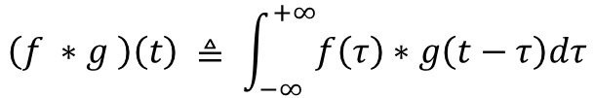
Plant Model
LTI Systems
Output is resolved by calculating
Weighted average of the output function at each time “t”
Weighting is given by shifting for time “t”
Defined as “Convolution”
Suppose input defined by a function f(t), impulse response by g(t), then
Convolution Function f(t) * g(t) produces the desired response function
Mathematically, it is defined as the integral of the product of two functions after one is reversed and shifted
Shifted – To compensate for varying inputs
Reversed – To compute Delta alone at each interval
$$\left(f ∗g \right)\left(t\right) ≜ \int_{−∞}^{+∞}{f\left(τ\right)∗g\left(t−τ\right)dτ}$$

Slide 13
Plant Model
LTI Systems
Sounds Complicated?
Well, it is sufficiently complicated.
Alternate Method Exists
f ( g * t ) = L[ f(t) ] x L[ g(t) ]
The convolution of two functions is equal to the product of Laplace transforms of the two functions
Makes things a lot more easier!!
Laplace transforms can be looked up from tables
Or solved using Mathematical Tools

Slide 14
Thank You!
In our next session:
Plant Model Development

